Slide 1
IT Workshop Project Report--
PROJECT NAME :C TEXT EDITOR
2nd Year CSE C
2nd Year CSE C
2nd Year CSE C
2nd Year CSE C
Ritika Pal
Saurabh Kumar
Aanisha Battacharya
Rohit Kumar Gupta

Slide 2
theory
This Project is based on application of tkinker (python). We have design menubar, listbox, scrollbar,button and many more with the help of tkinker widget.There is lot of GUI module in python But tkinter is easy way to design user interface…
This project take almost all coding language ,input .But it we have not added compilation and interpreter so, it is just a Editor.
I have uploaded full code in Github ..
https://github.com/rohitdhonicsk/pyide2

Slide 3
Function That can be done
1)You can Write Code
2)Save,Open,Save,New Function are implemented
3)You can change color of text and editor.
4)keyword of C are highlighted with blue color
5)copy, cut, paste are provided
6)Multiple coding language supported

Slide 4
Widget Required
1)Label
2)Entry
3)Button
4)Frame
5)Listbox
6)Menu Button
7)Menu
8)Text
9)Scrollbar
10)Toplevel

Slide 5
Information about widget
Button
To add a button in your application, this widget is used. Master is the parameter used to represent the parent window. There are number of options which are used to change the format of the Buttons. Number of options can be passed as parameters separated by commas.
Frame
It acts as a container to hold the widgets. It is used for grouping and organizing the widgets. There are number of options which are used to change the format of the widget. Number of options can be passed as parameters separated by commas
It is used to input the single line text entry from the user.. For multi-line text input, Text widget is used. The general syntax is: master is the parameter used to represent the parent window. There are number of options which are used to change the format of the widget. Number of options can be passed as parameters separated by commas.
Entry

Slide 6
Information about widget cont.
Label
It refers to the display box where you can put any text or image which can be updated any time as per the code. are number of options which are used to change the format of the widget.
Menubutton
It is a part of top-down menu which stays on the window all the time. Every menubutton has its own functionality.
It offers a list to the user from which the user can accept any number of options
Listbox
Text
To edit a multi-line text and format the way it has to be displayed
Scrollbar It refers to the slide controller which will be used to implement listed widgets.

Slide 7
Some Of property/Option used in the widget
highlightcolor: To set the color of the focus highlight when widget has to be focused.
bd: to set the border width in pixels.
bg: to set the normal background color.
cursor: to set the cursor used.
width: to set the width of the widget.
height: to set the height of the widget
command: to call a function.
font: to set the font on the button label.
image: to set the image on the button

Slide 8
Geometry Used In Project
There are mainly three geometry manager classes class.
pack() method:It organizes the widgets in blocks before placing in the parent widget.
grid() method:It organizes the widgets in grid (table-like structure) before placing in the parent widget.
place() method:It organizes the widgets by placing them on specific positions directed by the programmer.

Slide 9
Source code ---1
import tkinter as tk
from tkinter import ttk
import tkinter.colorchooser as colbox
import tkinter.filedialog as fbox
#keyword
list=["auto","break","case","char","const","continue","default","do","double","else","enum","extern","float","for","goto",
"if","int","long","register","return","short","signed","sizeof","static","struct","switch","typedef","union","unsigned",
"volatile","while","void"]
#creating window
window=tk.Tk()
window.title("C text Editor")
window.geometry("1000x800")

Slide 10
Source code part 2
#making menu bar
menu1=tk.Menu(window)
window.config(menu=menu1,bg="brown4")
fileMenu=tk.Menu(menu1,tearoff=False)
editMenu=tk.Menu(menu1,tearoff=False)
def aboutus():
frame2 = tk.Toplevel(window)
display = tk.Label(frame2, text=(""" This is Text Editor Designed for Coding in All the Language....\n Team member : \n
1)Saurabh Kumar \n2)Rohit Kumar Gupta\n 3)Aanisha Bhattacharya\n 4)Ritika pal"""),width=50,height=30,bg="skyblue",foreground="dark red",font=('Arial Rounded MT',16,'bold','italic'))
display.pack
theme=tk.Menu(menu1,tearoff=False)
about=tk.Menu(menu1,tearoff=False)
menu1.add_cascade(label="File",menu=fileMenu)
menu1.add_cascade(label="Edit",menu=editMenu)
menu1.add_cascade(label="Theme",menu=theme)
menu1.add_cascade(label="About",menu=about)
about.add_command(label="Info",command=aboutus)

Slide 11
Source code part 3
#adding function to file menu************************************************
def openfile(event):
filename=fbox.askopenfilename(initialdir=r"./",title="Open file",filetypes=[("All files","*.*")] )
def save(event):
filename=fbox.asksaveasfilename(initialdir=r"./",title="Save file",filetypes=[("All files","*.*")] )
#children of file menu***************************************************************************
fileMenu.add_command(label="New",accelerator='Ctrl+N',command=lambda event:textbox.delete(1.0,tk.END))
window.bind("<Control-n>", lambda:textbox.delete(1.0,tk.END))
fileMenu.add_command(label="Open",accelerator='Ctrl+o',command=openfile)
window.bind("<Control-o>", openfile)
fileMenu.add_command(label="Save",accelerator='Ctrl+s',command=save)
window.bind("<Control-s>", save)
fileMenu.add_command(label="Save as",accelerator='Ctrl+Shift+s',command=save)
window.bind("<Control-Shift-s>", save)
fileMenu.add_separator()
fileMenu.add_command(label="Close",underline=4,command=window.quit)
editMenu.add_command(label='Copy', accelerator='Ctrl+C', command=lambda:textbox.event_generate("<Control c>"))
editMenu.add_command(label='Paste', accelerator='Ctrl+V', command=lambda:textbox.event_generate("<Control v>"))
editMenu.add_command(label='Cut', accelerator='Ctrl+X', command=lambda:textbox.event_generate("<Control x>"))
editMenu.add_command(label='Clear All', accelerator='Ctrl+Alt+X', command= lambda:textbox.delete(1.0, tk.END))

Slide 12
Source code part 4
Lb = tk.Listbox(window,font=('Arial',15,'bold'),)
Lb.insert(1, ' C');Lb.insert(2, '\n\n');Lb.insert(3, ' Java') ;Lb.insert(4, '\n\n');Lb.insert(5, ' C++') ;Lb.insert(6, '\n\n');Lb.insert(7, ' Python 3') ;Lb.insert(8, '\n\n')
Lb.insert(9, ' Python') ;Lb.insert(10, '\n\n');Lb.insert(11, ' C#') ;Lb.insert(12, '\n\n');Lb.insert(13, ' Scala') ;Lb.insert(14, '\n\n');Lb.insert(15, ' Javascript') ;
Lb.selection_set( first = 0 )
#creating scroll bar and source code textbox*****************************************
frame1=tk.Frame(window) #scrollbar
scrollbar = tk.Scrollbar(frame1)
scrollbar.pack(side=tk.RIGHT,fill=tk.Y)
#text box
l1="1.0"
def retrieve_input(event):
z=textbox.index(tk.INSERT)
global l1
inputValue=textbox.get( l1,z)
l1=z
l=inputValue.split()
for i in l:
if i in list:
textbox.tag_add(i,"%d.%d" % (int(z[0]),int(z[2])-len(i)-1), "%d.%d" %( int(z[0]),int(z[2]) ))
textbox.tag_configure(i, foreground="blue", font='bold')

Slide 13
Source code part 5
def choosecolor1():
color=colbox.askcolor()
textbox.config(bg=color[1])
if(color=="white"):
window.config(bg="white")
else:
window.config(bg="brown4")
def choosecolor():
color=colbox.askcolor()
textbox.config(foreground=color[1])
theme.add_command(label="Text editor Color",command=choosecolor1)
theme.add_command(label="Text Color",command=choosecolor)
#label for input output and Run button*****************************************
label1 = tk.Label(window, text='INPUT',height=6,bg="yellow")
label2 = tk.Label(window, text='OUTPUT',height=4,bg="yellowgreen")
#Output Button
Run =tk.Button(window,text="Run",bg="burlywood1",width=10,height=3) #alignment of list box and Source code textbox*********************************
Lb.grid(row=0,column=0,ipadx=10,ipady=10,sticky='ns');
textbox.pack(side=tk.LEFT)
frame1.grid(row=0,column=1,columnspan=20,padx=10)
#alignment of list box and Source code textbox******************************************
Lb.grid(row=0,column=0,ipadx=10,ipady=10,sticky='ns');
textbox.pack(side=tk.LEFT)
frame1.grid(row=0,column=1,columnspan=20,padx=10)
#alignment of list box and Source code textbox******************************************
Lb.grid(row=0,column=0,ipadx=10,ipady=10,sticky='ns');
textbox.pack(side=tk.LEFT)
frame1.grid(row=0,column=1,columnspan=20,padx=10)
#alignment of input output box,un button,label********************************
label1.grid(row=1,column=0,sticky='e')
inputtextbox.grid(row=1,column=1,pady=20)
Run.grid(row=1,column=2,padx=2)
label2.grid(row=2,column=0,sticky='e')
outputtextbox.grid(row=2,column=1,padx=2)
#***************************************************************************
window.mainloop()

Slide 14
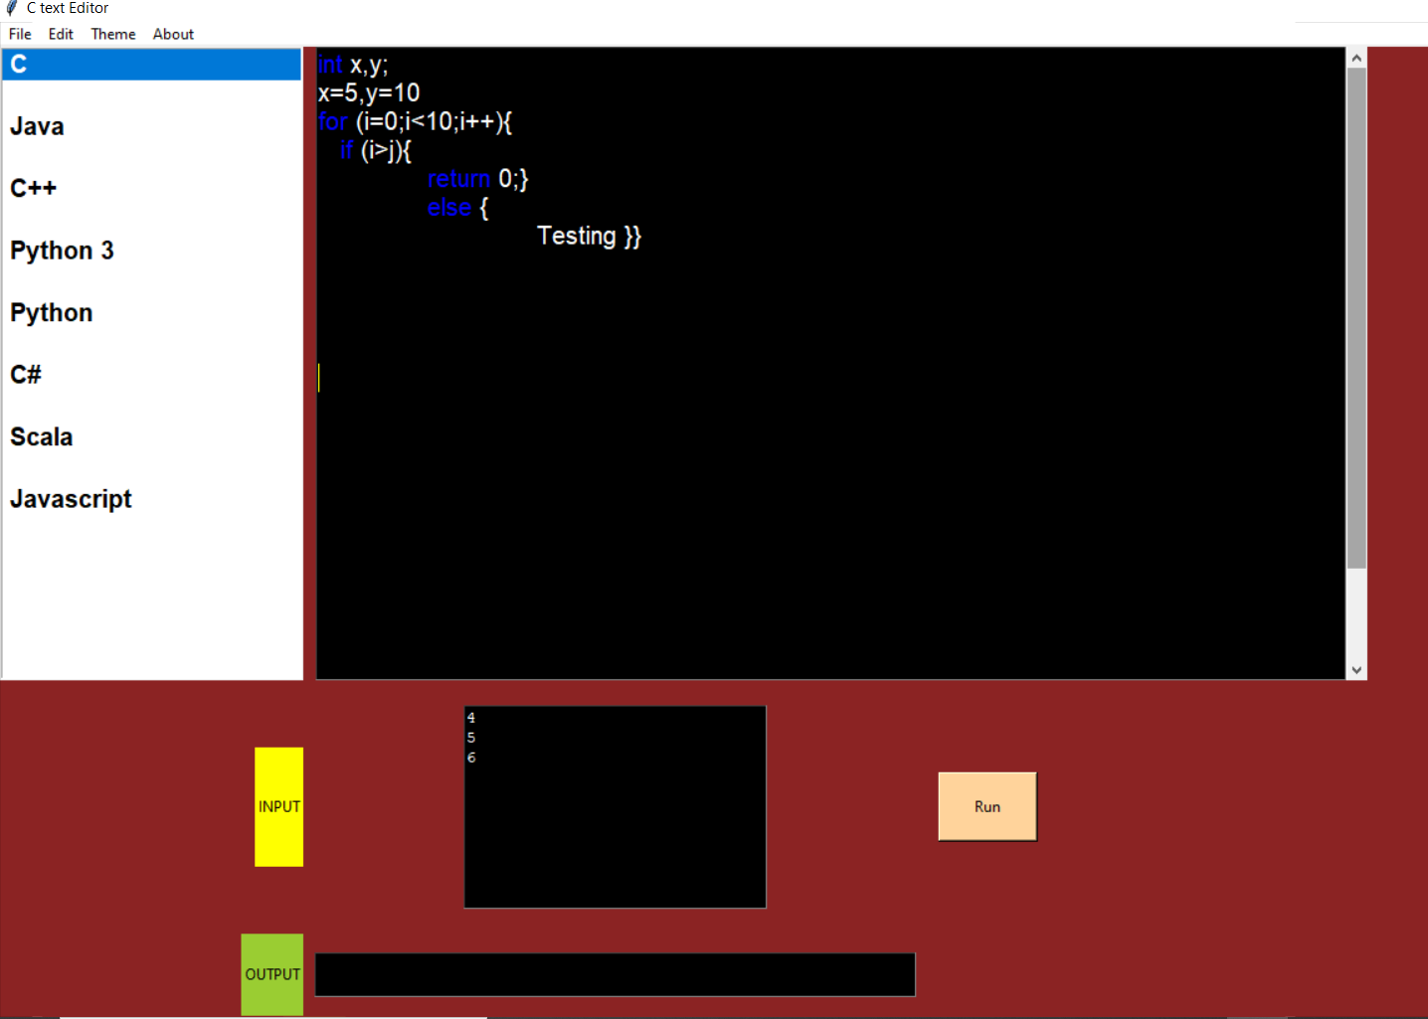
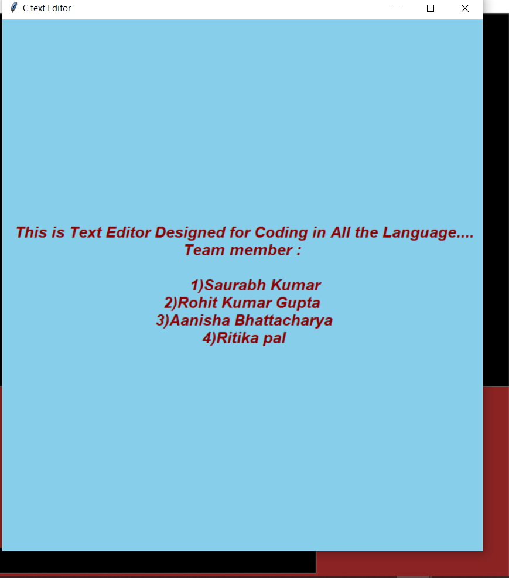
Output

Slide 15
Acknowledgement
In completing our project, we had to take the help and guideline of some respected persons, who deserve our greatest gratitude. The completion of this project gives us much pleasure. We would like to show our gratitude Prof. Sayantan Rana, CSE Department, IEM, for giving us a good guideline for project throughout numerous consultations. Team members have made valuable comment suggestions on this proposal which gave us an inspiration to improve our project. We thank all the people for their help directly or indirectly to complete our project.

Slide 16
Reference
https://www.geeksforgeeks.org/python-gui-tkinter/
https://www.tutorialspoint.com/python/python_gui_programming.htm
https://python-textbok.readthedocs.io › Introduction_to_GUI_Programming
https://stackoverflow.com/

